Slide 1


UNIT 1: Time for school
An English test

Slide 2
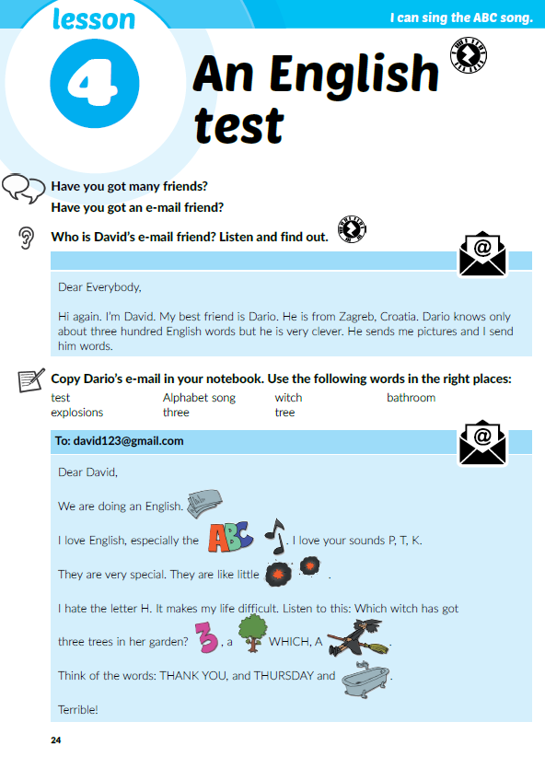

Have you got an e-mail account?
Have you got any e-mail friends?
What do you use your e-mail for?
Do you sometimes write e-mails in English?
Who is David’s e-mail friend?
Dario.

Slide 3
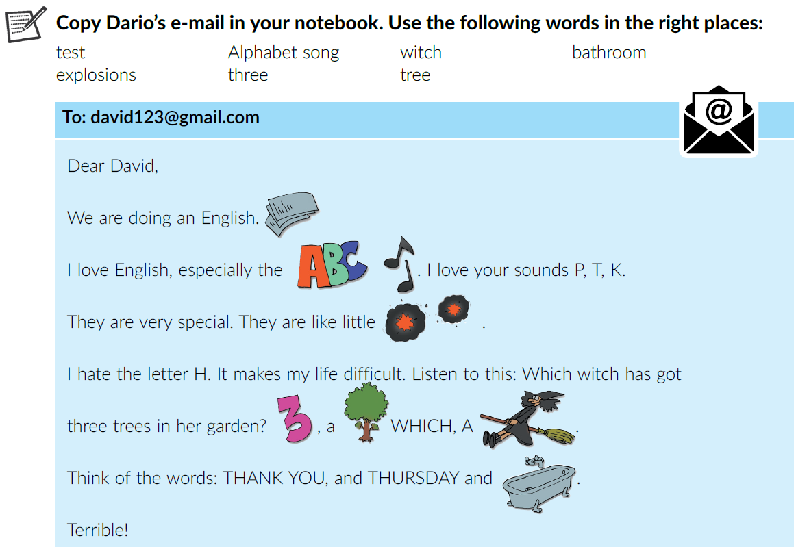
Match the words to the pictures in the e-mail.
test
Alphabet song
explosions
witch
three
tree
bathroom

Slide 4
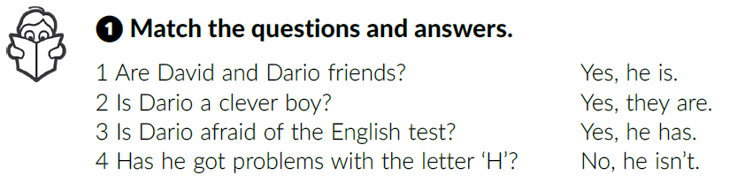
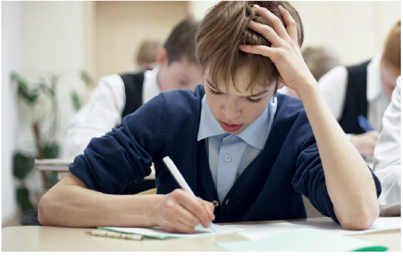
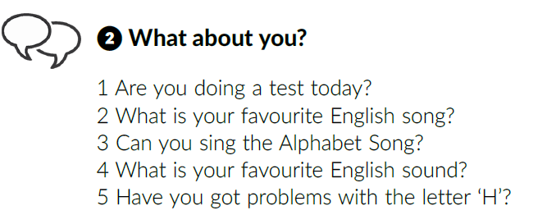
Work in pairs. Answer the questions.

Slide 5
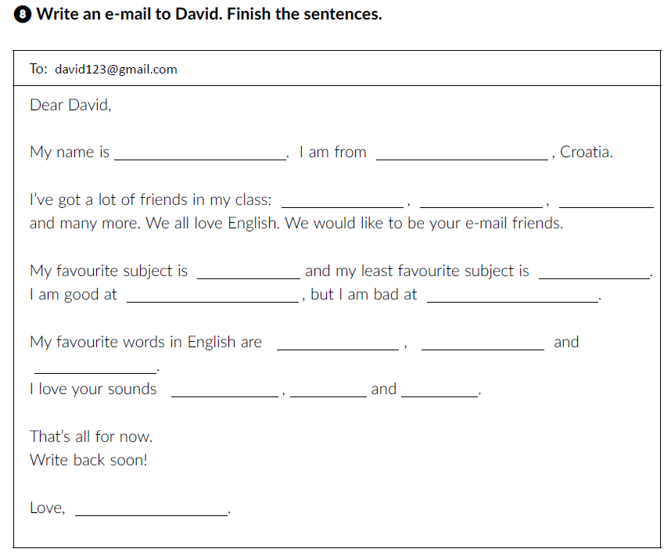
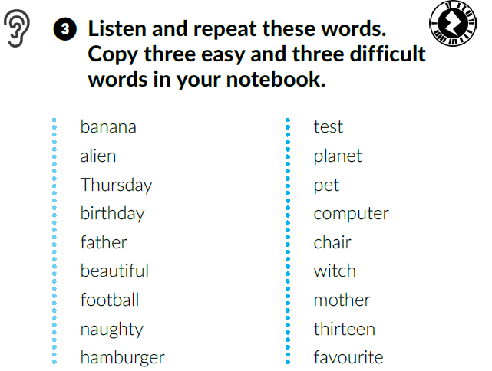
Which words are easy and which ones are difficult? Explain.
workbook p. 15

Slide 6
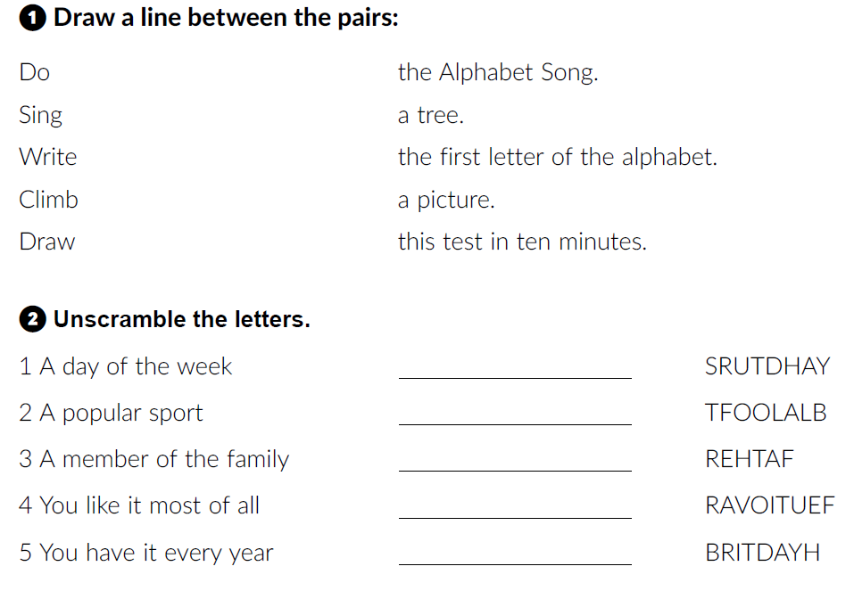
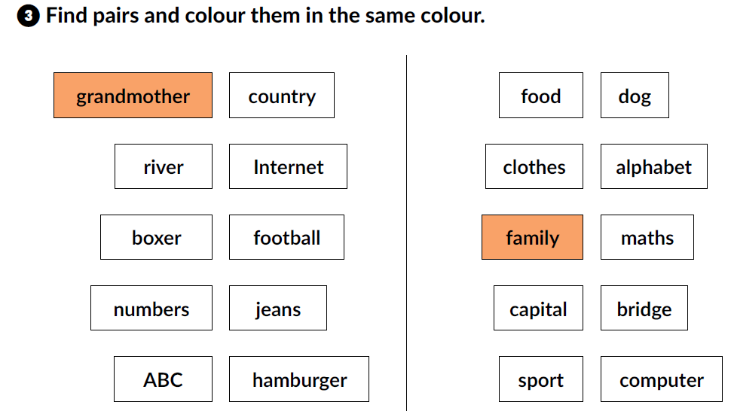
p. 13 workbook
Thursday
football
father
favourite
birthday

Slide 7

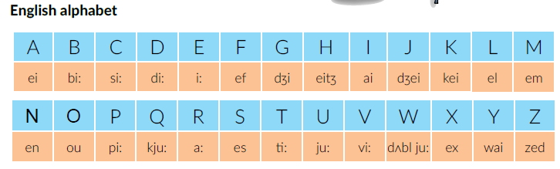

Click on the following link and choose ‘‘Play and learn: Alphabet quiz”
https://www.e-sfera.hr/dodatni-digitalni-sadrzaji/76727c70-ebc9-44cf-9eec-9baa876dadd8/
Q
X
Y
W

Slide 8
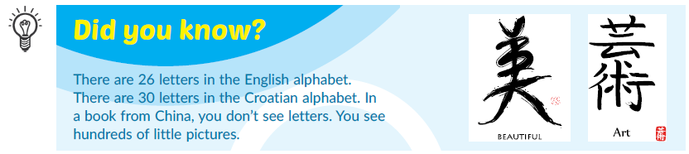
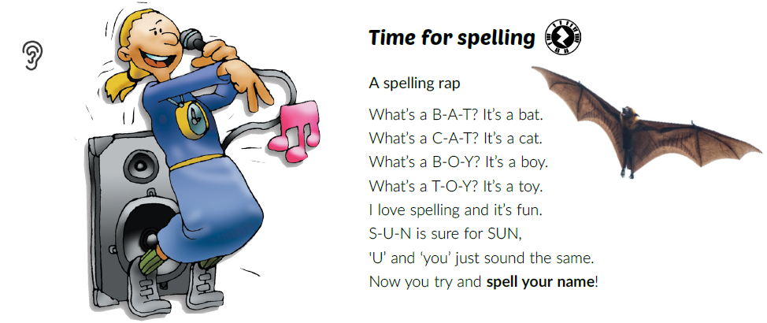
What’s the difference between the English and the Croatian alphabet?
Listen to the song.
What is spelling? Why is it important in English?
Sing along.
Spell your name!

Slide 9
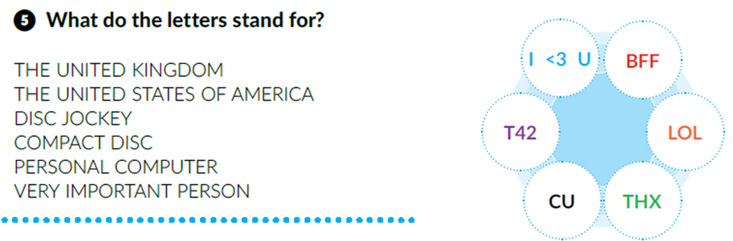
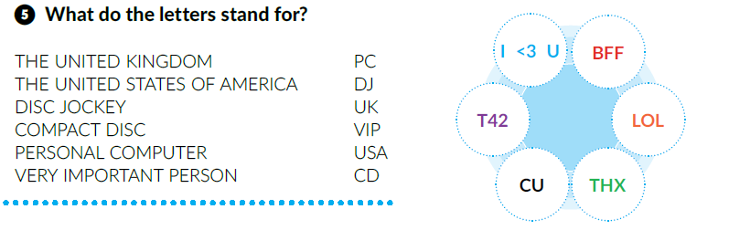
Match.
UK
USA
DJ
CD
PC
VIP
Read the abbreviations above.

Slide 10
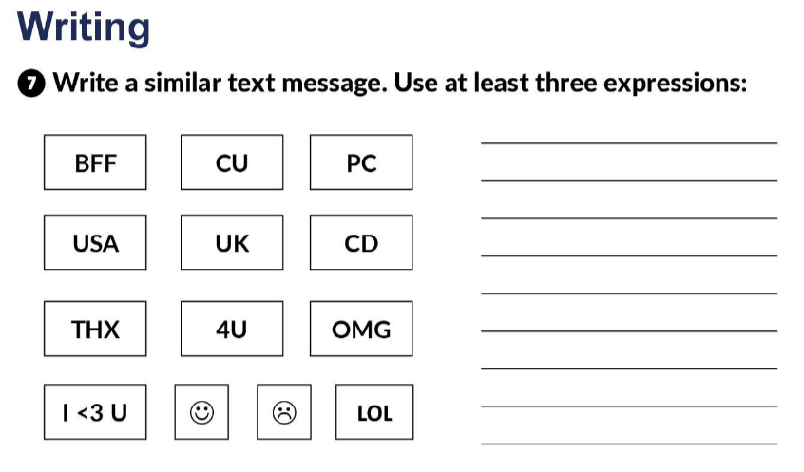
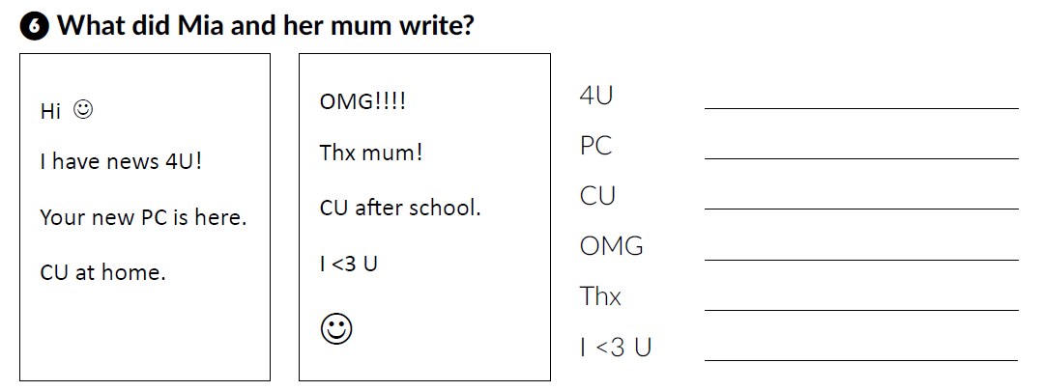
workbook p. 14/15
For you
Personal computer
See you
Oh my God
Thanks
I love you

Slide 11
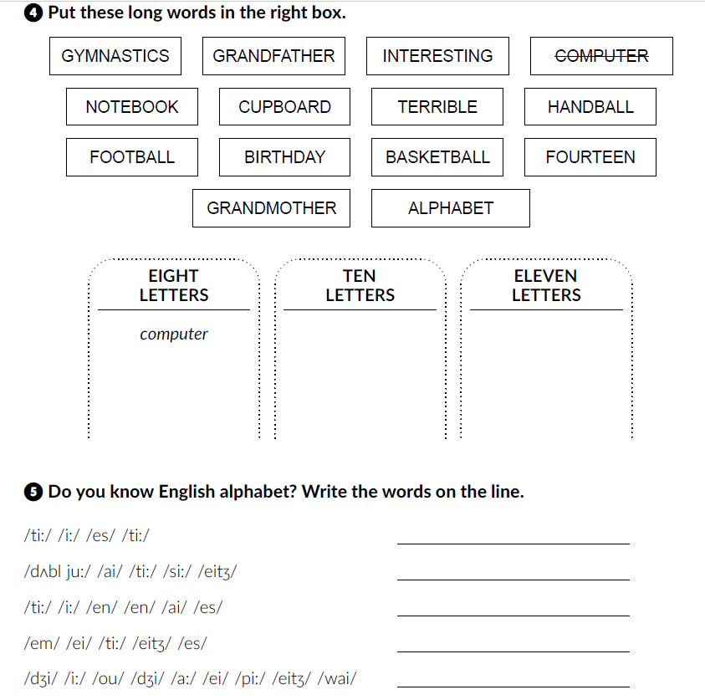


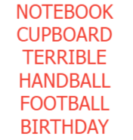
test
witch
tennis
maths
geography

Slide 12
Self check
https://www.e-sfera.hr/dodatni-digitalni-sadrzaji/76727c70-ebc9-44cf-9eec-9baa876dadd8/

